Slide 1
Assignment No. 10
Title: Factory Design pattern
Aim:Design and implement Factory design pattern for the given context. Consider Car building process, which requires many steps from allocating accessories to final makeup. These steps should be written as methods and should be called while creating an instance of a specific car type. Hatchback, Sedan, SUV could be the subclasses of Car class. Car class and its subclasses, CarFactory and TestFactoryPattern should be implemented.
Objectives: To learn the concept of Design pattern
Theory:
Design pattern
Factory design pattern diagram with example
Advantages of factory design pattern
Usage and the application where factory design patterns can be applied .

Slide 2
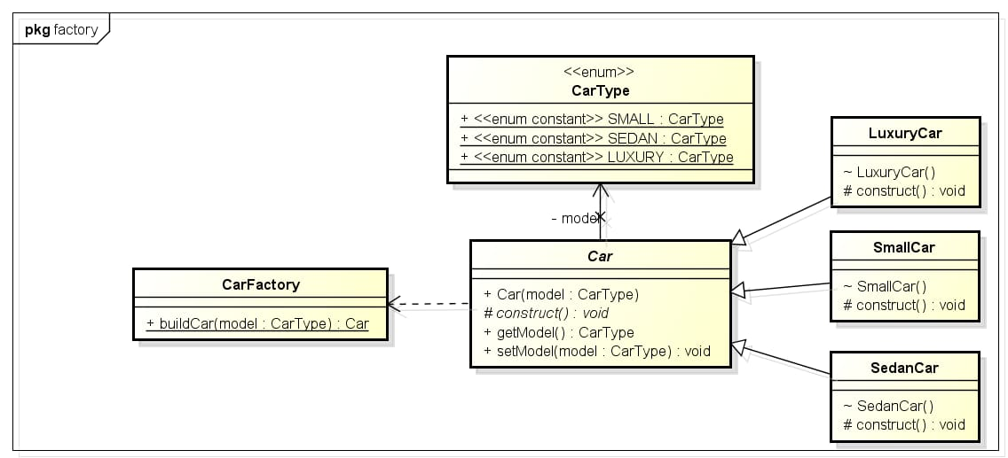
Assignment No. 10
Sample Code:
Draw the class diagram for given context
Input: Design and implement Factory design pattern for the given context. Consider Car building process, which requires many steps from allocating accessories to final makeup. These steps should be written as methods and should be called while creating an instance of a specific car type. Hatchback, Sedan, SUV could be the subclasses of Car class. Car class and its subclasses, CarFactory and TestFactoryPattern should be implemented.

Slide 3
Assignment No. 10
Car.java
package factorypattern;
public abstract class Car {
public Car(CarType model) {
this.model = model;
arrangeParts();
}
private void arrangeParts() {
// Do one time processing here
}
// Do subclass level processing in this method
protected abstract void construct();
private CarType model = null;
public CarType getModel() {
return model;
}
public void setModel(CarType model) {
this.model = model;
}
}
CarFactory.java
package factorypattern;
public class CarFactory {
public static Car buildCar(CarType model) {
Car car = null;
switch (model) {
case SMALL:
car = new SmallCar();
break;
case SEDAN:
car = new SedanCar();
break;
case LUXURY:
car = new LuxuryCar();
break;
default:
// throw some exception
break;
}
return car;
}
}

Slide 4
Assignment No. 10
CarType .java
package factorypattern;
public enum CarType {
SMALL, SEDAN, LUXURY
}
SedanCar.java
package factorypattern;
public class SedanCar extends Car {
SedanCar() {
super(CarType.SEDAN);
construct();
}
@Override
protected void construct() {
System.out.println("Building sedan car");
// add accessories
}
}
LuxuryCar.java
package factorypattern;
public class LuxuryCar extends Car {
LuxuryCar() {
super(CarType.LUXURY);
construct();
}
@Override
protected void construct() {
System.out.println("Building luxury car");
// add accessories
}
}

Slide 5
Assignment No. 10
SmallCar.java
package factorypattern;
public class SmallCar extends Car {
SmallCar() {
super(CarType.SMALL);
construct();
}
@Override
protected void construct() {
System.out.println("Building small car");
// add accessories
}
}
TestFactorypatern.java
package factorypattern;
public class TestFactoryPattern {
public static void main(String[] args) {
System.out.println(CarFactory.buildCar(CarType.SMALL));
System.out.println(CarFactory.buildCar(CarType.SEDAN));
System.out.println(CarFactory.buildCar(CarType.LUXURY));
}
}

Slide 6
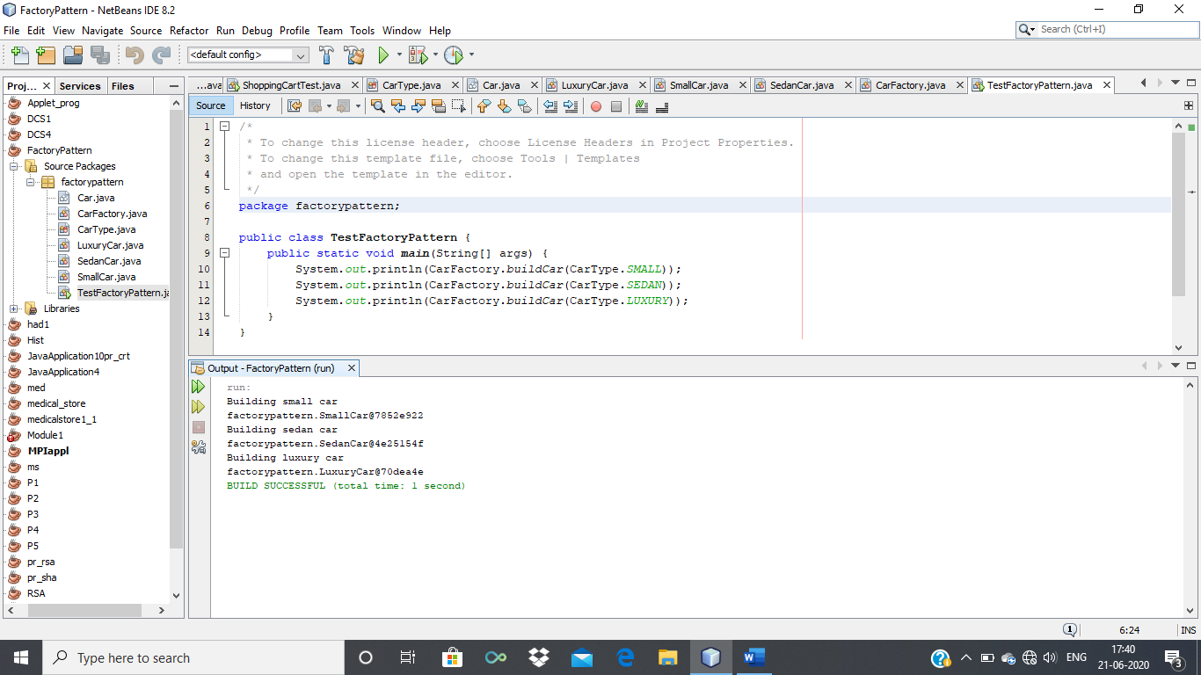
Output :.
Factory pattern –
Building small car
factorypattern.SmallCar@7852e922
Building sedan car
factorypattern.SedanCar@4e25154f
Building luxury car
factorypattern.LuxuryCar@70dea4e
BUILD SUCCESSFUL (total time: 1 second)
Assignment No. 10

Slide 7
Assignment No. 10
Validation:
Class identification and design is correct .
Identify an algorithm (i.e. a behavior)
Specify the signature for given context
Text Book referred for assignment 10
Erich Gamma, Richard Helm ,Ralph Johnson, John Vlissides, “Design Patterns ,Elements of Reusable Object- Oriented Software” ISBN-13: 978-0201633610
Rohit Joshi, “Java Design patterns, Reusable solutions to common problems” Java Code Geeks

Slide 8
Assignment No. 10
Frequently Asked Questions:
Give the applications where design patterns can be applied ?
Why factory pattern?
Explain factory pattern?
Draw the design Pattern with a context.
Give examples of creational design pattern .
Design application by applying the factory pattern .
Represent and implement a Shape interface which implements Circle ,Square, rectangle using Fatory pattern
Represent and implement for bill generation using GetPlanFactory to get a Plan object. Pass information (Domestic / commercial/ institutional) to get the type of object it needs.
Mapping of Course Outcomes for Assignment 10: CO6
CO6: Apply appropriate design patterns to provide object-oriented solutions

Slide 9
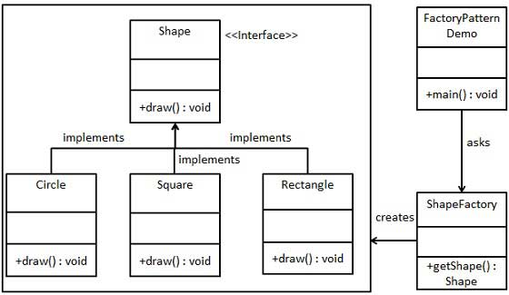
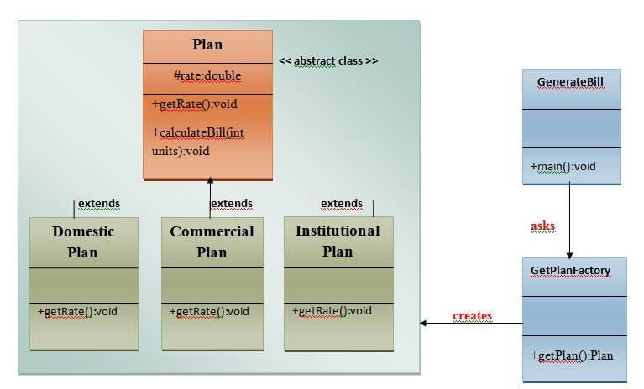
Assignment No. 10
Sample diagram for Factory Design pattern

